Slide 1

MIMIC Visualization
Ankita Savaliya
AI In Healthcare Course at UT Austin

Slide 2
Coding environment and packages
Google Colab
MIMIC-III Demo Dataset
Used Google Drive for saving and loading MIMIC CSV data
Libraries Used: matplotlib, seaborn, plotly, WordCloud, altair
GitHub and Google Colab Links:
https://colab.research.google.com/github/AnkitaSavaliya/AIH/blob/main/MIMIC_Visualization.ipynb
https://github.com/AnkitaSavaliya/AIH/blob/main/MIMIC_Visualization.ipynb (Note: Visualizations from certain libraries may not render properly in the raw (blob) view on the GitHub link due to known limitations. Please use the provided Colab link to view all visuals correctly.)
https://github.com/AnkitaSavaliya/AIH/blob/main/MIMIC%20Visualization.pptx

Slide 3
Data Load and Initial Setup
Used PATIENTS.CSV, ADMISSIONS.CSV, DIAGNOSES_ICD.CSV, D_ICD_DIAGNOSES.CSV, ICUSTAYS.CSV, PRESCRIPTIONS.CSV, PROCEDUREEVENTS_MV, D_ITEMS, etc.
Created the initial dataframe using PATIENTS, ADMISSIONS, and DIAGNOSES_ICD.
Merged the dataframe with other CSV files as needed for visualization.
Represented all visuals using different types of charts.

Slide 4
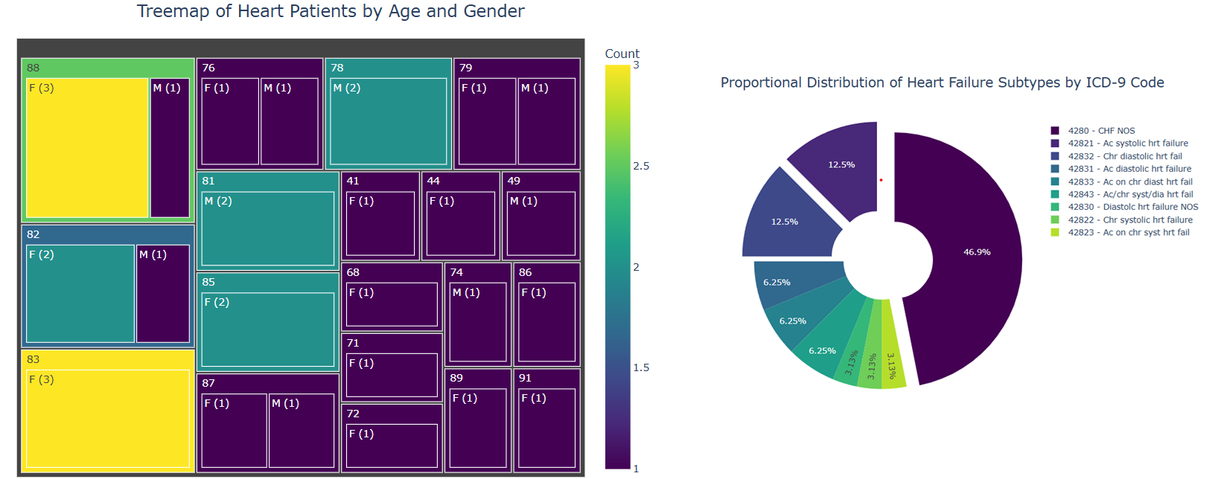
Visual 1- Heart Patient Analysis: Gender, Age, and ICD-9 Subtypes
This visualization represents heart patients, showcasing their age and gender distribution. It also includes an interactive pie chart displaying the proportional distribution of heart failure subtypes.

Slide 5
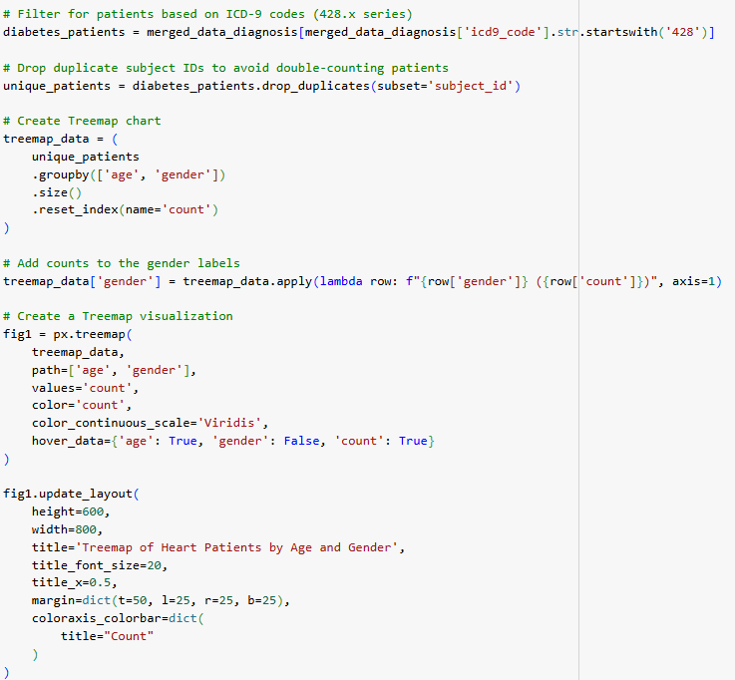
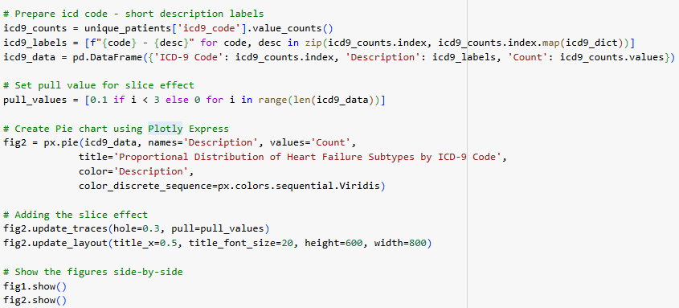
Visual 1 - How to recreate
Filters patient records based on ICD-9 codes (428.x series) and drops duplicate patients using their unique IDs. Counts the gender distribution among unique patients and plots a treemap. Counts the occurrences of each ICD-9 code, prepares labels, and creates an interactive pie chart using Plotly Express.

Slide 6
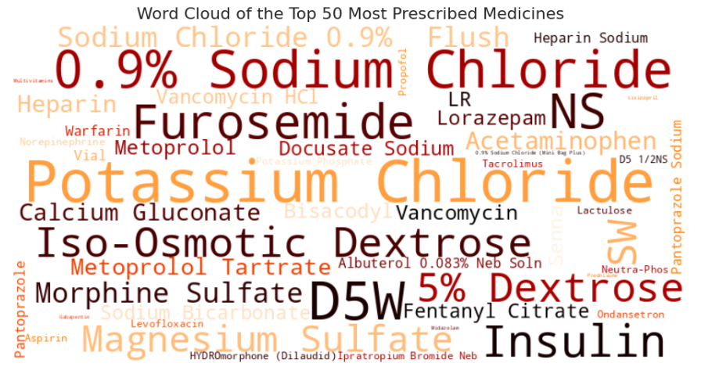
Visual 2 - Word Cloud of Most Prescribed Medicines
This visualization is a word cloud showcasing the top 50 most prescribed medications.

Slide 7
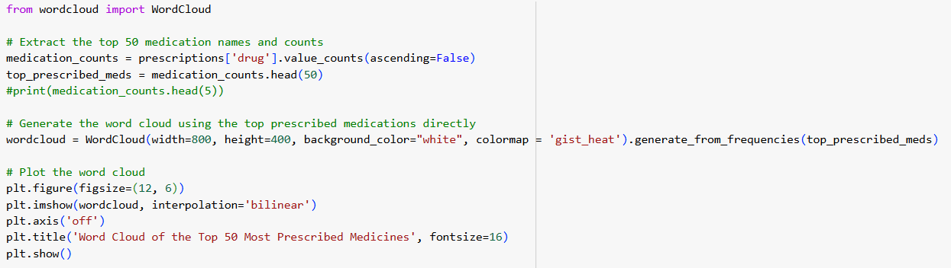
Visual 2 - How to recreate
Extract the top 50 most prescribed medication names and their counts from the dataset. Create and display a word cloud using the frequency of these medications, with larger font sizes representing higher prescription counts.

Slide 8
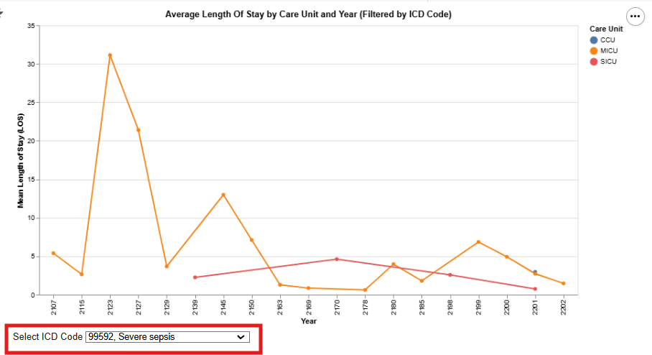
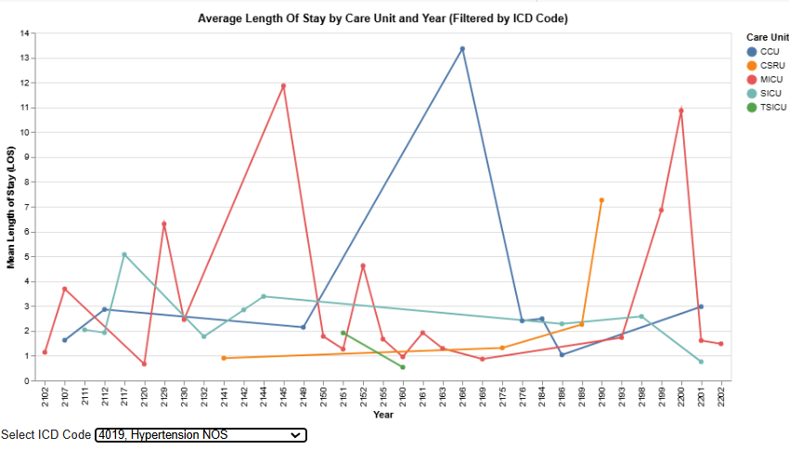
Visual 3 - Average Length of Stay by Care Unit and Year (ICD Code Filtered)"
This visualization is an interactive line chart created with Altair, analyzing the average length of stay (LOS) by care unit and year, dynamically filtered by ICD-9 codes.

Slide 9
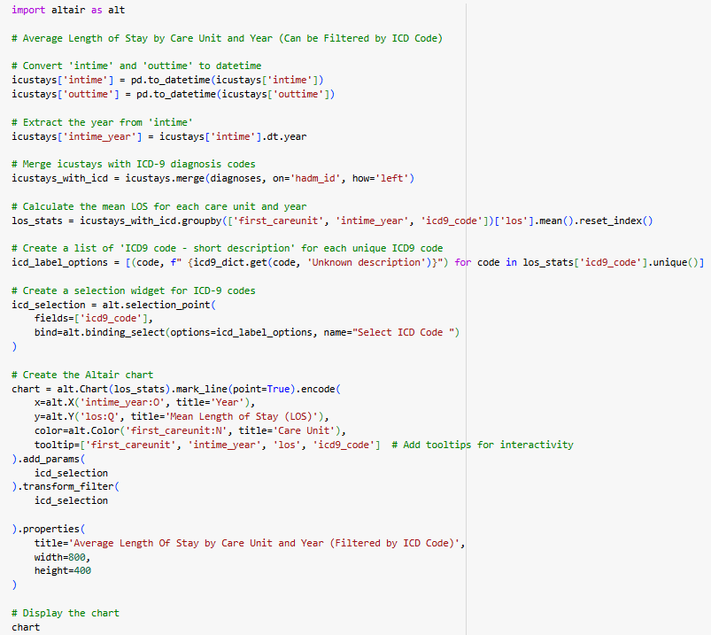
Visual 3 - How to recreate
Converts ICU stay times to datetime format and extracts the year and merges ICU stay data with ICD-9 diagnosis codes.
Calculates the mean LOS for each care unit and year.
Creates and display a line chart(altair) showing trends in LOS by care unit and year with selection box for ICD-9 code.

Slide 10
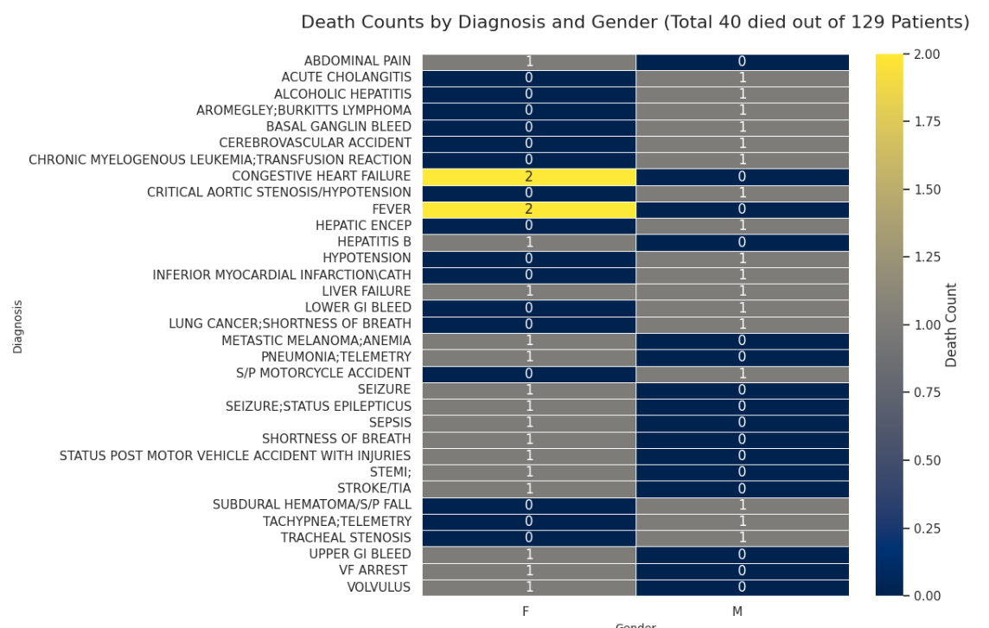
Visual 4 - Death Counts by Diagnosis and Gender
This visualization represents deceased patients categorized by their diagnosis and gender.

Slide 11
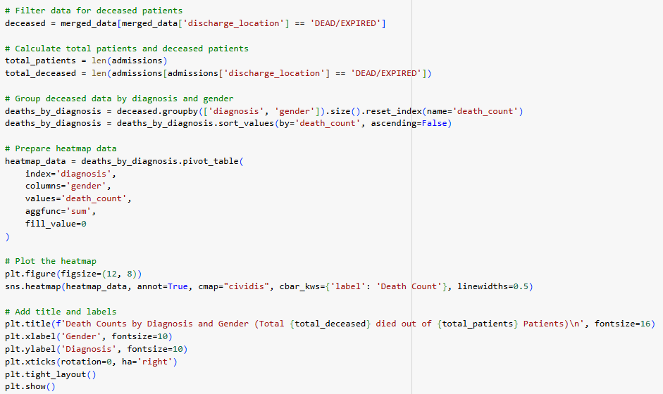
Visual 4 - How to recreate
Filter the data for deceased patients.
Aggregate the death counts by diagnosis and gender.
Create and plot a heatmap to visually compare death counts across diagnoses and genders.

Slide 12
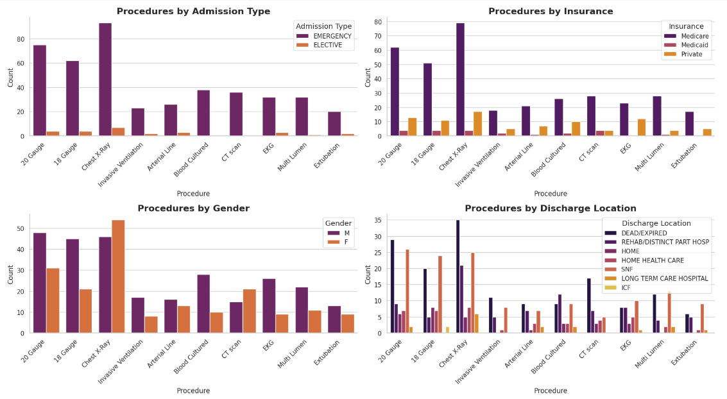
Visual 5 - Analysis of Most Performed Procedures
This visualization represents the analysis of the 10 most performed procedures across admission type, insurance types, gender, and discharge location.

Slide 13
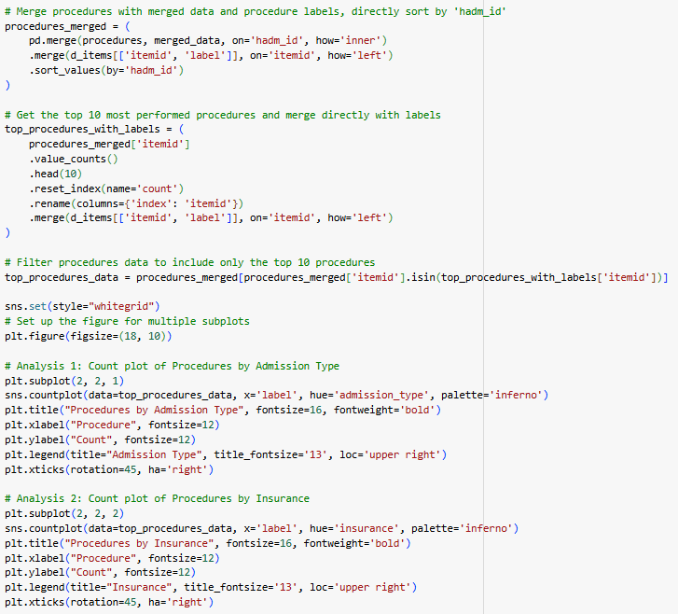
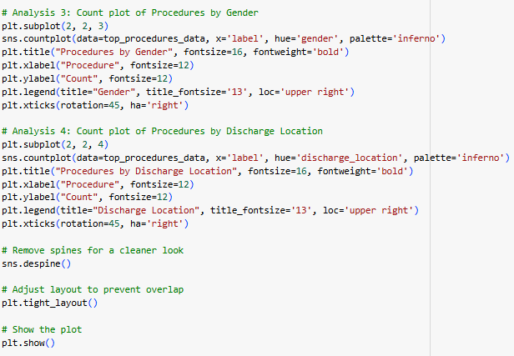
Visual 6 - How to build/recreate
Create a dataframe with existing data and merge procedure data with procedure labels. Extract the top 10 procedures and plot a countplot using this information."

